Slide 1
Captain Gigabyte
ENGR COMP 24-780 (Fall 2024)
Syntax_Error

Slide 2
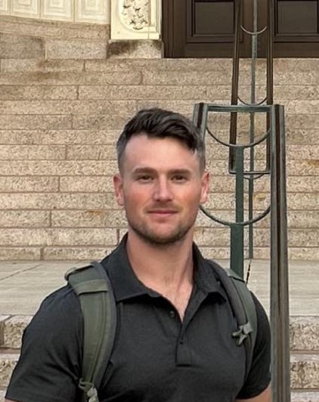
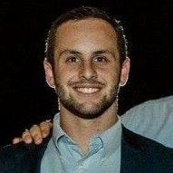
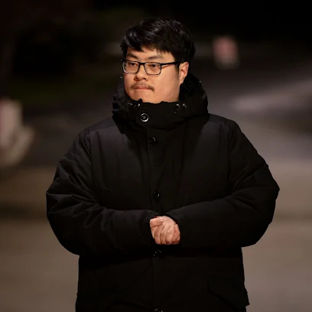
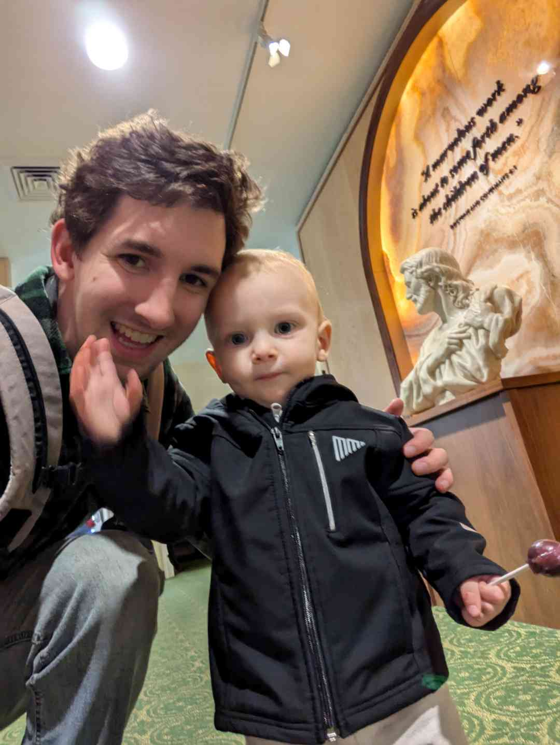

The Team
Jesse Barkley
Project Leader
Jonathan Roberts
Object Developer
Sky Song
UI Developer
Nate Salazar
Object Developer
Zihao Liu
Build Engineer

Slide 3
INTRO SCREEN
User Experience
The user is met with intro screen graphics and pirate themed music.
Intro Screen Functionality
Select Start Game: User selects start game to play! Followed by “Start Game” the user will enter username information prior to playing.
Select Leaderboard: If the user wishes to see previous player scores, the user can select “Leaderboard” to view recent high scores.
Select Exit: The user can select exit to terminate the game.
ey
INSERT GRAPHIC HERE

Slide 4
GAME PLAY SCREEN
User Experience
The user will immediately begin battle with enemy pirate ships. The goal is to avoid obstacles and enemy fire while engaging and destroying the enemy as quickly as possible!
Game Play Functionality
Up Arrow (FSKEY_UP): Move the ship forward
Left Arrow (FSKEY_LEFT): Turn the ship left
Right Arrow (FSKEY_RIGHT): Turn the ship right
A Key (FSKEY_A): Fire right side cannons
D Key (FSKEY_D): Fire left side cannons
ey
INSERT GRAPHIC HERE

Slide 5
OUTRO SCREEN
User Experience
The user will receive status of Victory or Defeat with the corresponding score saved to the username.
Outro Screen Functionality
Press ESC: The user can press escape to return to the intro screen. From here, the user can play another game, view the leaderboard, or exit the game.
ey
INSERT GRAPHIC HERE

Slide 6
KEY LIBRARIES/CLASSES USED
User Interface (Intro and Outro)
Sound Manager
#include "yssimplesound.h"
Utilized for all sound functionalities.
class SoundManager
Class initializes and loads all sound files.
Game Objects
ey

Slide 7
CHALLENGES
Team Dynamics
The team was comprised of varying skill sets, coding preferences, and project ideas. Deciding how to tackle the project and assign roles was critical.
Our Solution:
Maximize team input in meeting one
Vote on the best project idea
Assign roles based on ability and talent
Create project timeline for critical components and assign responsibility
Collaborative Coding
Coding as a team is challenging. Component code had to function cohesively without error.
Our Solution:
Initial attempt at combining all code (Failed! But that is expected)
Debugging Efforts as a team. Version Control!! (BetaCode V1, BetaCode V2, etc..)
Get the program to run! It doesn't have to look good yet
Collaborative refinement (Now make it look better)
ey

Slide 8
Thanks for Playing!
Question?
ENGR COMP 24-780 (Fall 2024)
Syntax_Error

